Slide 1
Reddit Search Engine Optimization Project
DSO 599 - Text Analytics
Chengqin Kui | Haoshen Yu | Min Yoo | Naiyuan Xiao | Shuyi Tao | Tong Xie

Slide 2
Agenda
Business use case
Model methodology
Implementation roadmap
Potential return on investment of our research / model

Slide 3

Business Use Case
“Reddit is one of the largest and most underutilized social media marketing platforms. Reddit is ranked the #6 most visited website in the United States (#17 globally), with an average daily user time of 11:29 compared to Facebook’s 9:34.”
According to Alexa.com
Company: Reddit search engine optimization team
Challenge: Increase readership for reddit audience within the worldnews community.
Goal:
Analyze text data for worldnews articles to identify hot articles vs not hot articles.
Optimize internal search algorithm with our model to recommend hot articles.
Increase time spent on website for readers by 5%.
Recommend an implementation plan for management team.

Slide 4
Model Methodology
Data from Kaggle, over 509,236 titles ranging from 2008 to 2016
time_created - a Unix timestamp of the submission creation date
date_created - creation time in %Y-%m-%d
up_votes - total counts of upvotes of the submission
down_votes - total counts of downvotes of the submission, all 0s
title - the title of the submission
over_18 - age range of the post for readers
author - reddit username of the author
subreddit - category of the titles, ‘'worldnews'
Raw Data

Slide 5
Model Methodology
Logistic Regression, Gradient boosting tree, Neural Network
Variable Creation
Model Evaluation
Data Exploration
Data Modeling
Text and non-text variables

Slide 6
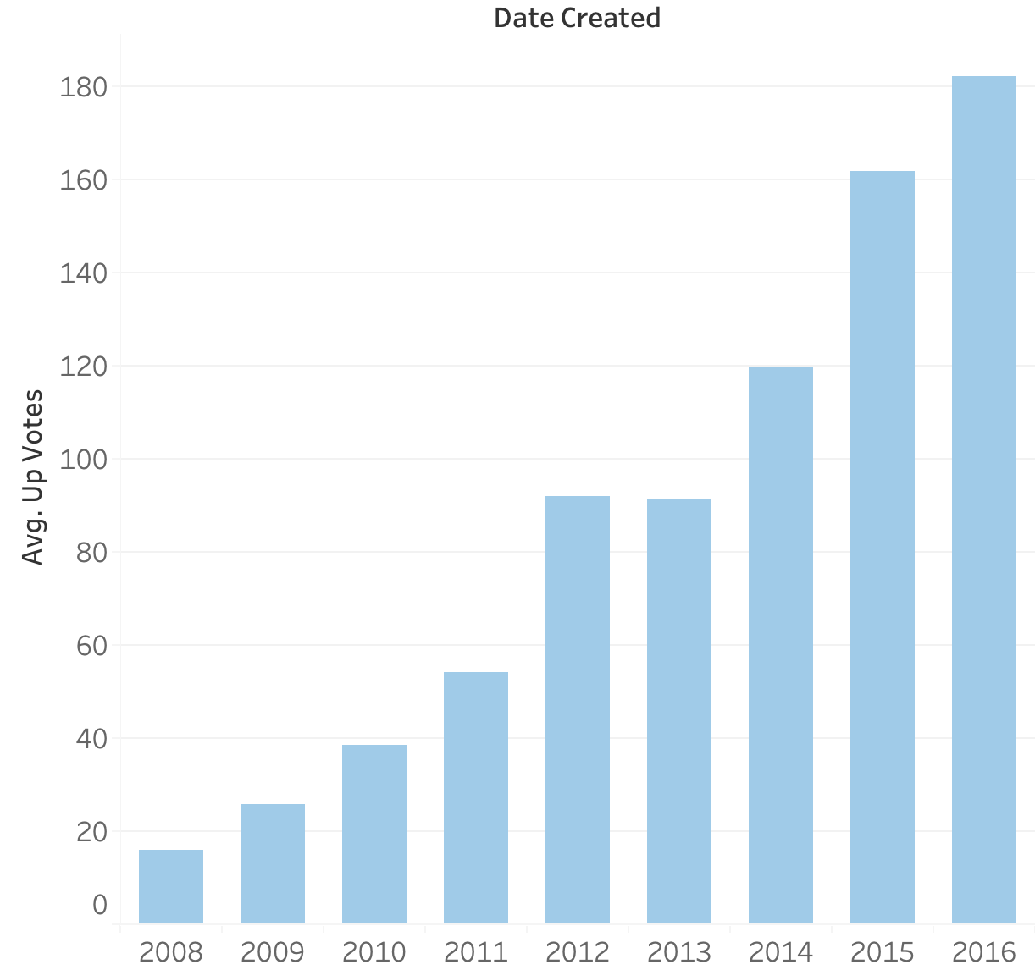
Data Exploration
number of up_votes rose with time
Reddit became popular during this period (2008-2016).
To eliminate the influence of time, we add "hot" label based on whether the total counts of upvotes are in the top 5 percentile in every year's posts.

Slide 7
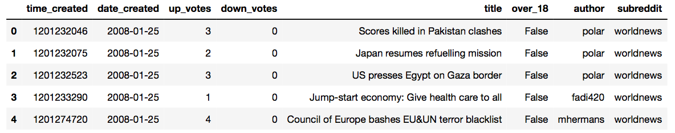
Variable Creation
Text-related variables (“title”)
Preprocessing
(remove stopwords, lemmatization)
TF-IDF Vectorizer
(letters with 3 or more, 2000 max features)
TF-IDF weighted Word2Vec
Notes:
TF-IDF matrix 500,000 * 2000
Word2vec 2000 * 300
So TF-IDF weighted matrix is 500,000 * 300
PCA 0.9 301 → 141

Slide 8
Variable Creation Cont’d
Non-text variables (“author”)
Train & test data split (30% for testing)
Hot_Author variable: whether the author has written a hot article in train data set
Dimensionality Reduction
PCA (Principal Component Analysis): reduce correlation between independent variables and reduce computation
Number of features: 301 → 141

Slide 9
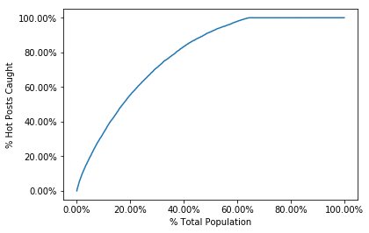
Evaluation Metric
Detection Rate @5%:
# of hot posts in top 5%
# of all hot posts
(based on likelihood)
random guess
what % of all the hot posts are caught at a particular examination cutoff location.
Example: DR 50% at 5% means the model catches 50% of all the hot posts in 5% of the population.
Notes:
It’s more robust and meaningful than the False Positive measure of goodness.

Slide 10
Model Performance
Model | Train DR@5% | Test DR@5%
Logistic Regression | 17.02% | 17.14%
GBDT | 20.79% | 18.40%
Neural Network | 28.31% | 19.86%
random guess
Parameter for Neural Network:
Optimizer: lbfgs
Hidden Layers: 2
Neurons: 21,6
L2 Penalty parameter: 1e-5
detection rate on testing for Neural Network
Notes:
Gradient Boosted Decision Trees (GBDT) is a machine learning algorithm that iteratively constructs an ensemble of weak decision tree learners through boosting
Neural Network makes use of an architecture inspired by the neurons in the brain. It learns about collected data and then predict outcomes.

Slide 11
Implementation Roadmap
Implementation on “worldnews” subreddit
Implement our model to optimize the existing search engine algorithm for “worldnews” subreddit.
Re-train model
Based on analysis, re-train the model with more data in order to increase performance.
Q1 2020
Q3 2020
Q3 2019
Q2 2020
Analyze results
Analyze time spent on “worldnews” subreddit site for one quarter. Compare with historical data for performance results.
Apply to top 10 subreddit communities
Top 10 subreddit communities have between 12 to 20 million subscribers. Focusing on these subreddits will have the biggest bang for buck.

Slide 12
Return on Investment
5%
Time Spent on Site
CPM
Current state:
22 million subscribers
Average time spent on site - 15:50 minutes, 5M pageviews per day
Current CPM is $1.50.
Future state / Estimated Outcomes:
Better prediction of “hot” articles to recommend to readers
Increase time spent on site by 5%
Increase revenue for ads placed on “hot” articles
Increase CPM with more readership.
Source: https://www.techjunkie.com/demographics-reddit/

Slide 13

Thank You

Slide 14
Q & A

Slide 15
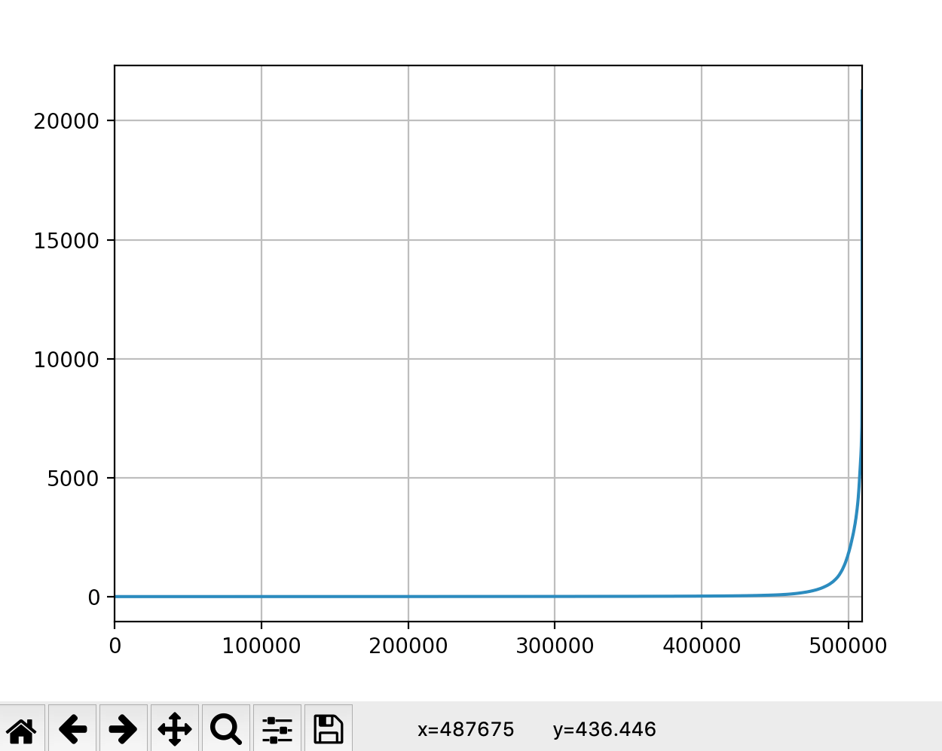
Appendix - Label Creation Logic
1- 487675/509236
≈5%

Slide 16
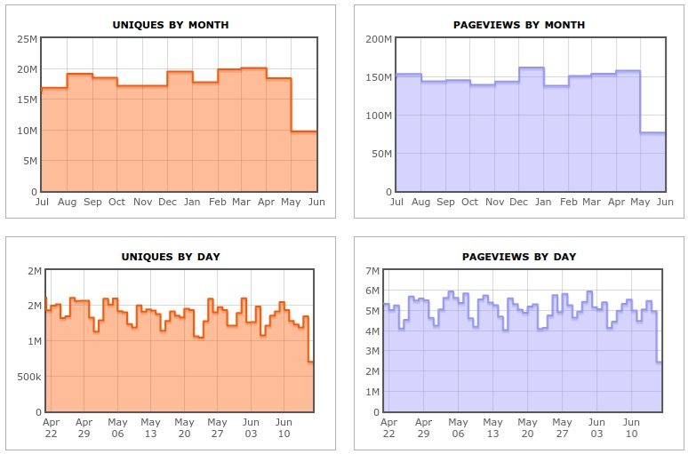
Reddit Traffic Report
Notes:
https://www.quicksprout.com/reddit-marketing/

